Slide 1
INVENTORY MANAGEMENT SYSTEM

Slide 2

CONTENTS
1 2 3 4 5 6 7
ABOUT US
INTRODUCTION
OBJECTIVES
PROJECT SCOPE
FEATURES
METHODOLOGY
CONCLUSION

Slide 3
ABOUT US
GROUP MEMBERS
PRATHAMESH BHUSHAN GAWAS
SOHAM SHRIDHAR KADAM
PARAS AJIT KADAM
PROJECT GUIDE:-
PROF. OMKAR DIKE

Slide 4
INTRODUCTION
The Inventory Management System helps businesses keep track of their stock, manage orders, and analyze sales more easily.
It includes useful features like product catalog management, automatic alerts for restocking, order tracking, and detailed reports.
PURPOSE
Helps businesses keep track of what's in stock, handle orders, and look at sales numbers right away
Makes it easier to watch inventory with automatic warnings when items need to be restocked
Gives simple reports and easy-to-read screens to help make better business choices
Makes the whole order process smoother, from when an order is placed to when it's delivered
Helps small and medium businesses work better and spend less money

Slide 5
OBJECTIVES
OUR AIM
To simplify stock management and reduce errors by automating inventory processes.
THE GOAL
To enhance business efficiency, prevent stock issues, and improve customer satisfaction.

Slide 6
PROJECT SCOPE
Real-time Tracking: The system shows what’s in stock at any time, helping avoid running out of items or having too much.
Order Management: It takes care of orders from start to finish, making the process easier.
Simple Reporting: The system gives clear reports and visual charts to help make better decisions.
Cost Savings: Better inventory management helps reduce waste and save money.

Slide 7
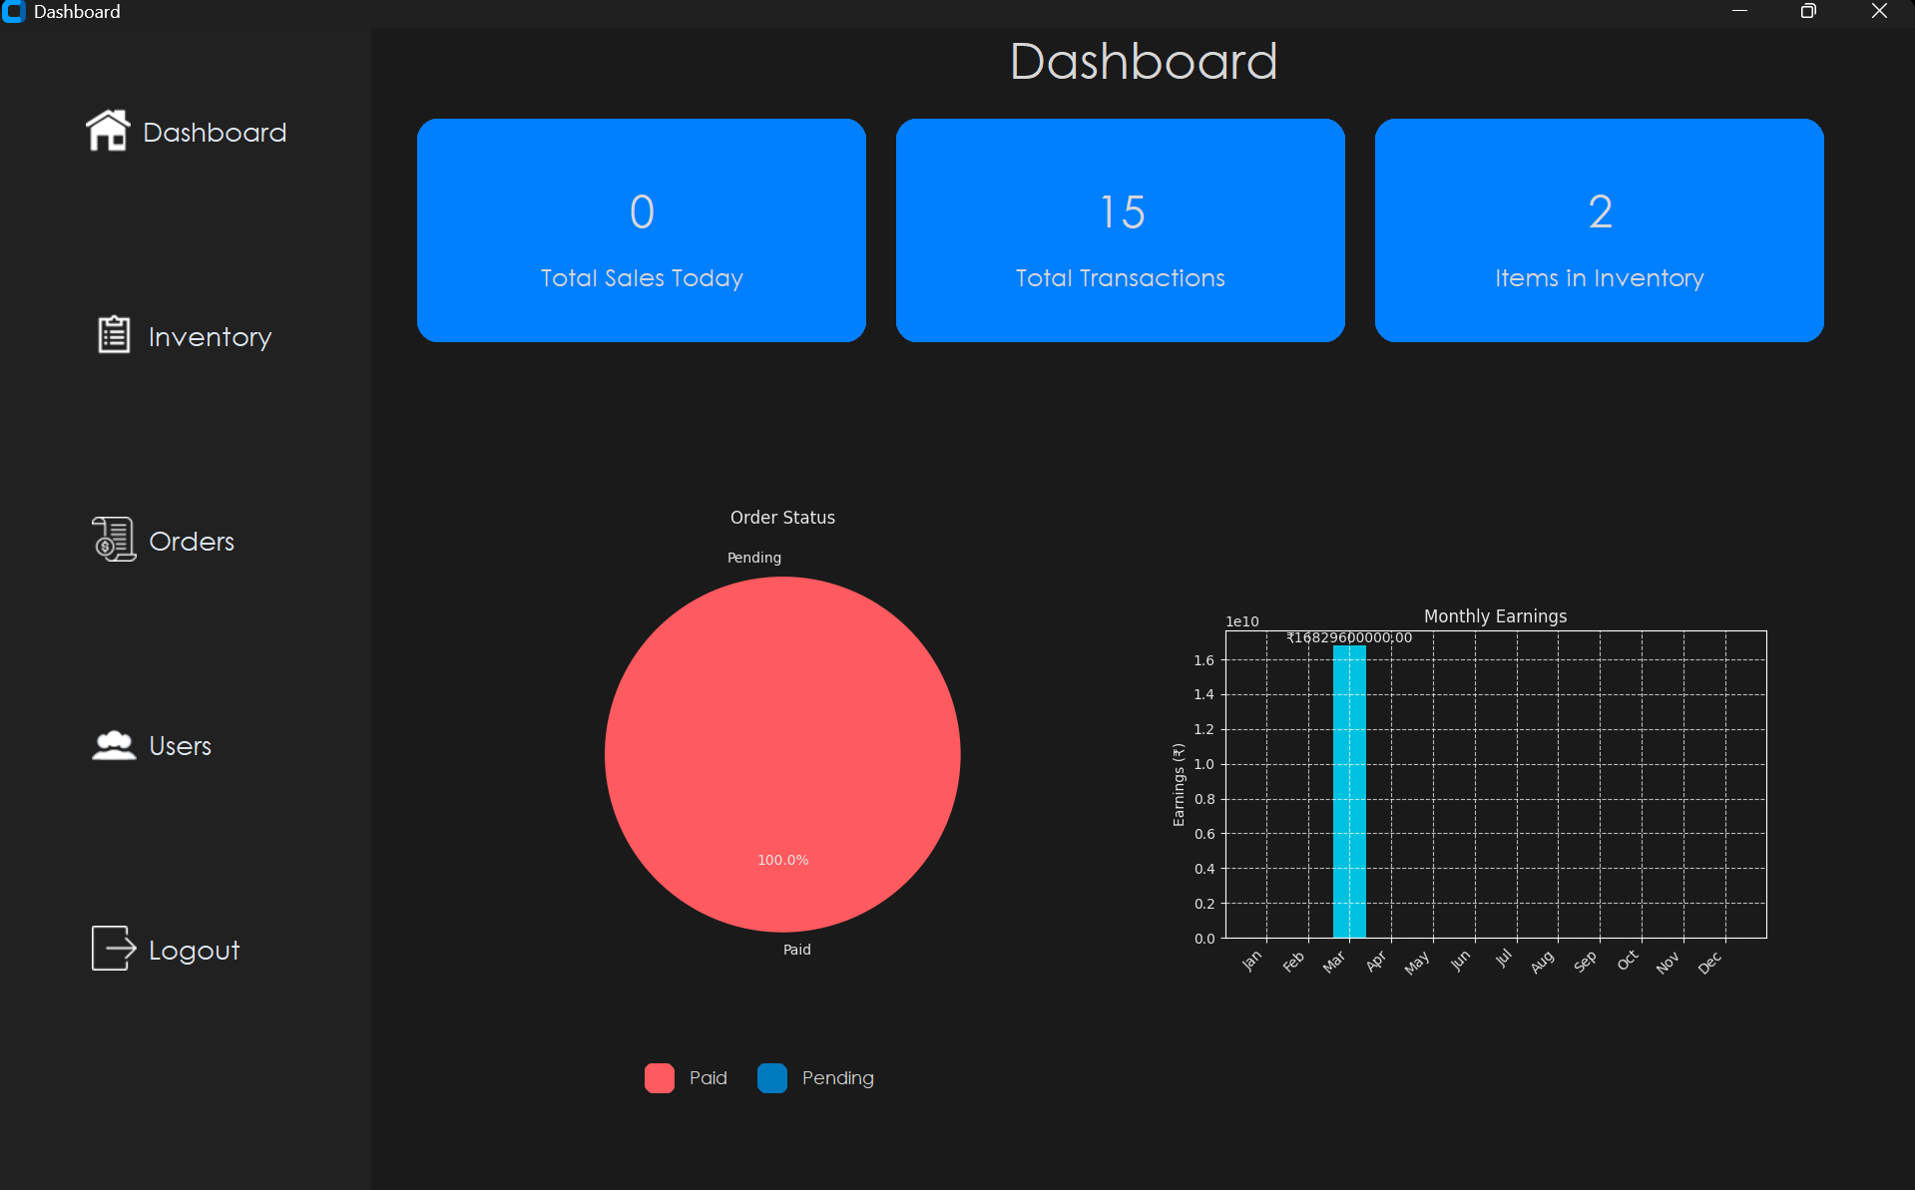
FEATURES
DASHBOARD

Slide 8
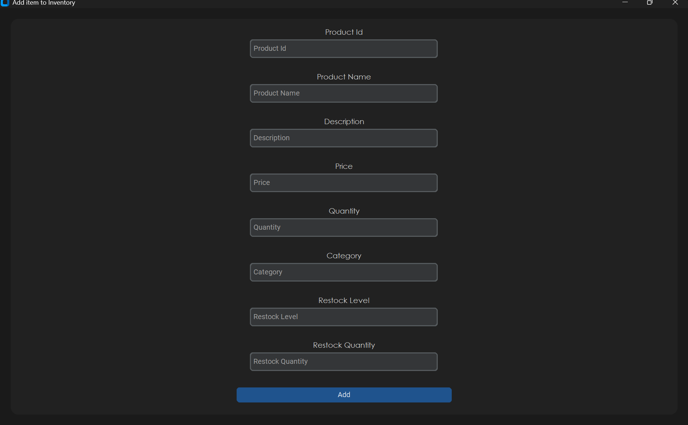
FEATURES
ADD ITEM (ADMIN)

Slide 9
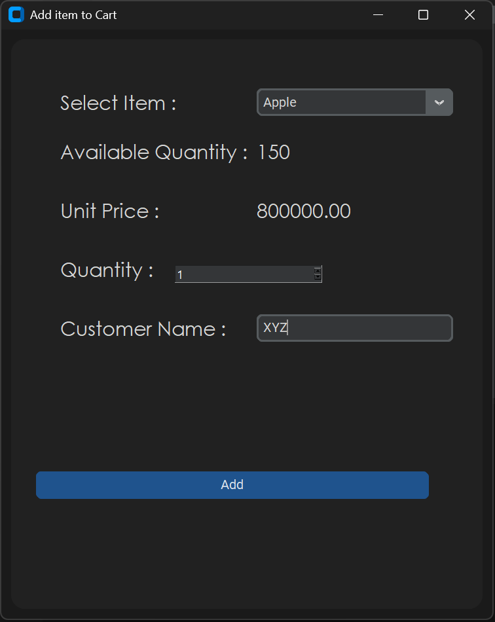
FEATURES
SELL ITEM (BILLER)

Slide 10
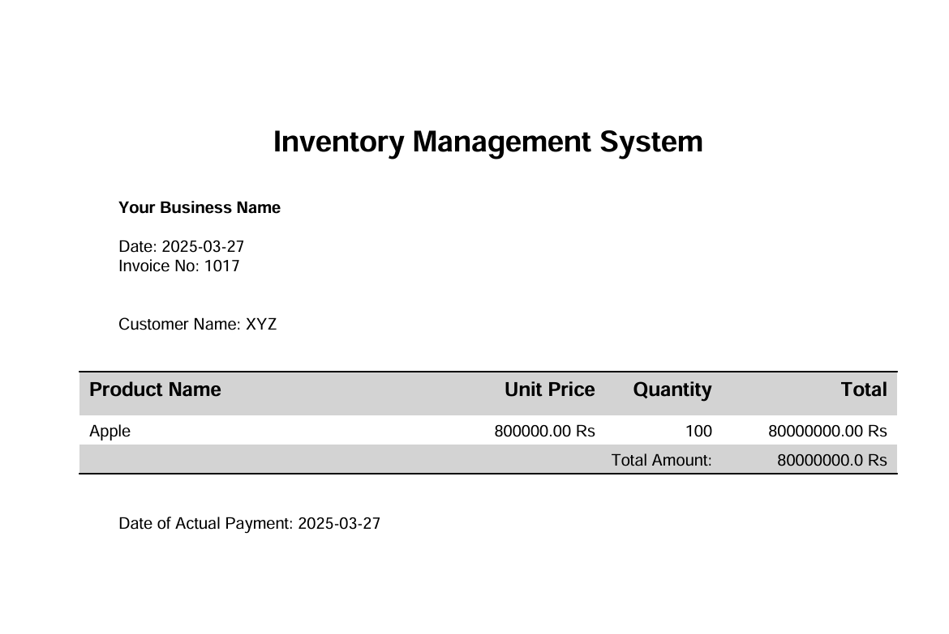
FEATURES
INVOICE GENERATION (BILLER)

Slide 11
METHODOLOGY
Requirements Gathering: We have taken reference about some research papers and learn about their inventory usages and how to implement in a management system.
System Design: We planned a easy-to-use system with features like real-time tracking, order management, and reporting to solve these problems.
Development: We created the system using Python for the interface and MySQL for storing data, making sure it's simple to use.
Testing: We carefully tested the system to make sure all features work properly and made improvement based on project requirement.

Slide 12



TECHNOLOGY USED
PYTHON
CUSTOM TKINTER (GUI)
MYSQL (DATABASE)

Slide 13
CONCLUSION
The Inventory Management System efficiently tracks stock, manages orders, and provides valuable insights to help businesses operate more effectively and economically, and we are committed to making this system available for academic projects in the coming year to support learning and innovation in inventory management solutions.

